Slide 1
Unit- 2 Human resource management part -2

Slide 2

HUMAN RESOURCE MANAGEMENT
Personnel, People at work, Manpower, Staff, employees

Slide 3
What is Management???
It is the art of getting Work done through other People.
Management in business and organizations is the function that coordinates the efforts of people to accomplish goals and objectives using available resources efficiently and effectively.

Slide 4

What is HR????
Human resources is the set of individuals who make up the workforce of
an organization, business sector, or economy.
other terms sometimes used include "manpower", "talent", "labour", or simply "people".

Slide 5
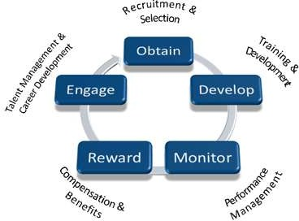
Definition
Human resource management can be defined as
– “ employing people, developing their resource, utilizing maintaining and compensating their services in tune with the job and organizational requirements”

Slide 6
HRM - Definition
It is defined as the art of procuring, developing and maintaining competent workforce to achieve the goals of an organization in an effective and efficient manner.
“HRM is the function performed in organizations that facilitates the most effective use of people to achieve organizational and individual goals.”

Slide 7
Definition
HRM is planning, organizing directing and controlling of the procurement , development, compensation , integration, maintenance, and separation of human resources to the end that individual, organizational and social objectives are accomplished.
Core Elements of HRM
Organizations ------People ------ Management.
The HRM process consists of planning, attracting, developing, and retaining the human resources (employees) of an organization

Slide 8
Concept
Human resource management means management of people at work. HRM is the process which binds people with organizations and helps both people and organization to achieve each others goal. Various policies, processes and practices are designed to help both employees and organization’s to achieve their goal.

Slide 9
Human resource management is branch of management that deals with people at work, it is concerned with the human dimensions of management of the organization. As organization consists of people, therefore acquiring them, developing their skills, providing them motivation in order to attain higher goal and ensuring that the level of commitment is maintained are the important activities.

Slide 10
Human Resources help in transforming the lifeless factors of production into useful products.
They are capable of enlargement i.e capable of producing an output that is greater than the sum of inputs. Once they get inspired, even ordinary people can deliver extraordinary results.
They can help an organization achieve results quickly , efficiently and effectively.

Slide 11
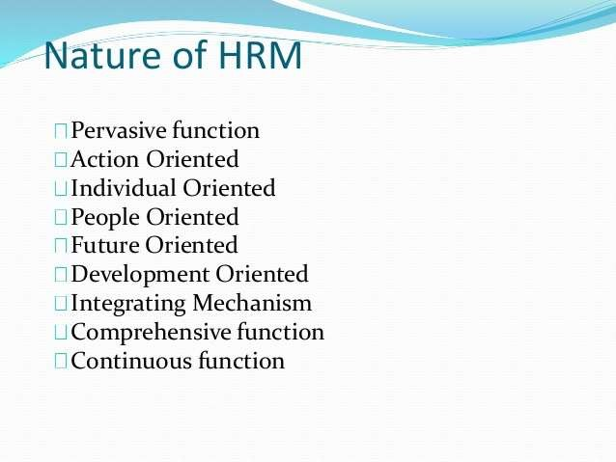

Slide 12
Nature of HRM
Inherent part of management- selecting people, training, motivating, appraising their performance for improving their quality.
Pervasive function-present in all levels of mg in an organization
Action oriented-solve problem through rational(balanced) policies rather than record keeping
People oriented-HRM is all about people at work. Assign jobs, produce results, reward, motivate them towards improvements in productivity
Future oriented- Effective HRM helps organization meet its goals
Development oriented-HRM develops full potential of employees through reward, training, job rotation.
Integrating mechanism: HRM maintains cordial relationship between people working at various levels in organization.
Comprehensive function: Workforce signifies people working at all levels, HRM differs with form & shape but the basic objective of effective utilization of human resource remains the same.
Continuous function: HRM is not a one shot deal it requires constant awareness
and alertness of human relations in every day operation.
Based on human relation: Every person has different need, perception and expectations. The manger should give due attention to these factors.

Slide 13



Objectives of HRM
To help the organization reach its goal
To employ the skills and abilities of the workforce efficiently
To provide the organization with well trained & well motivated employees
To increase employees job satisfaction and self actualization (stimulate employees to realize their potential)
To develop & maintain a quality of work life.
To communicate HR policies to all employees.
To be ethically & socially responsive to the needs of the society(ensuring compliance with legal & ethical standards)
To provide an opportunity for expression & voice in management
To provide fair, acceptable & efficient leadership
To establish sound organizational structure & desirable working relationships.

Slide 14
HRM FUCTIONS
HR
acquisition
HR planning
Recruitment
Selection
Placement
Motivation & maintenance
Empowerment
Health & Safety
HR mobility
Creating motivating environment
HR
development
1. Career planning 2.Training &
development
3.Organizational Development
Performance & compensatio n
Performance Mg
Incentives& benefits
Industrial
relations
Discipline & grievance mg
Industrial dispute Mg
HR Information system HR research
HR accounting
HR audit

Slide 15
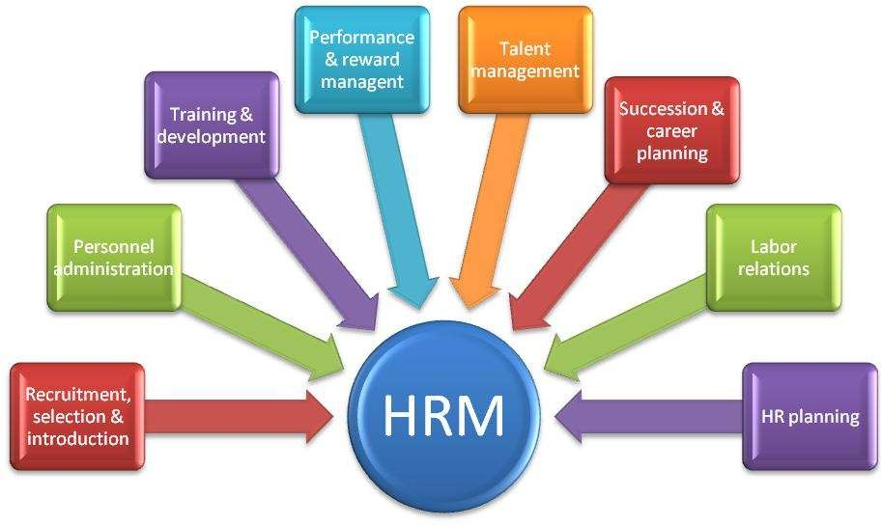
Functions of HRM

Slide 16



Importance of HRM
Attract & retain talent
Train people for challenging roles
Develop skills & competencies
Promote team spirit
Develop loyalty & commitment
Increase productivity & profits
Improve job satisfaction
Enhance standard of living
Generate employment opportunity
Greater trust & respect
GOOD HR PRACTICES HELPS

Slide 17


Scope(capacity) of HRM
Human resource planning-fill various position
Recruitment & Selection- develop a pool(team) of candidates
Job Design: define task, assign authority & responsibility
Training & Development- helps in developing key competencies
Appraisal of performance-systematic assessment & evaluation of workforce
Motivation of workforce- develop enthusiastic workforce
Remuneration of employees-focuses on fair, consistent & equitable compensation
Social security & Welfare of employees-working conditions,
transport, medical assistance etc
Review & audit of personnel policies- ensures reliable HR policies
Industrial labour relation- ensures healthy union mg
relationship e.g.: settlement of dispute

Slide 18
Difference between personnel mg & HRM
PERSONNEL MANAGEMENT HUMAN RESOURCE MG
Mg of people employed •
Mg of employees skills,
Knowledge, abilities
Employees are treated as economic, social & psychological man
Employee are treated as a
resource
Employees as treated as profit center. Therefore, invest in human resource.
Employees used for multi-mutual benefit for org, employees & family
HRM is a strategic(planned) mg function
Long term perspective
Employees are treated as economic man as his service are exchanged with salary
Employee are viewed as tool,
equipment
Employee are treated as cost center. Therefore mg controls cost of labour
Employees used as organization
benefit
Personnel function is only auxiliary (secondary)
Short term perspective

Slide 19


Qualities of HR Manager
Henry fayol categorized as
Physical- health, vigor (energy, strength), address
Mental- ability to understand, learn, judge & adaptable
Moral – firmness, responsible, initiative, loyal, dignity (self respect)
Educational- subject knowledge about function performed
Technical- peculiar knowledge on function
Experience – arising from work proper. OTHERS:
Alert mentally, competent to take quick decision, honesty & integrity, patience, good leader, socially responsible, good communicator, courteous (well mannered)

Slide 20


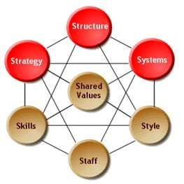

Role & Responsibility of HR professionals in changing Environment
Focus on strategic HR issues: Issues have to be identified &
dealt with adequately. It will act as an in-build advantage
Proactive action: not on reactive basis. Putting action in practice before an issue arises.
Developing integrated HR system:
Well balanced system without lack of coherence (unity) in function
Working as Change agent: must perceive need for change and initiate it. HR professionals must play an active role.
Marketing HR potential: must have ability to prove
their contribution to enterprise
Outsourcing HR functions: business instructs an
external supplier to take responsibility (and risk)
for HR functions.

Slide 21
Competing In a Global Economy :
Companies compete in a global economy many are introducing new technologies that require more educated and trained workers.
Successful Organizations must hire employees with the
knowledge to compete in an increasingly sophisticated market.
Competing in global market requires more that educating and training workers to meet new challenges
Successful organizations institute quality improvement
processes & introduce change efforts
Workforce must learn to be culturally sensitive to communicate & conduct business among different cultures
Developing managers to be global leaders has been identified
as a major challenge for organization

Slide 22

To increase the work efficiency
To maintain the relationship between organizations and employees
To Stand on Competition
To exists in this competitive business world
22

Slide 23

Strong employees
Competitive advantage
6

Slide 24
What Does this Mean?
Job Specifications
Career Management
Learning & Development
Career Paths ensure that employees have skills necessary to perform at job specification levels.
Learning & Development courses will be linked to specific Career Paths and Career Progression Plans at all levels.
Core Competencies
Performance
Management
Core Competencies will be defined by and linked to the Performance Management system.
Learning & Development courses will focus on Core Competency development.
Cultural Traits

Slide 25
SUBJECTS COVERED BY COMPANY HR POLICIES
Small business owners should make sure that they address the following basic human resource issues when putting together their personnel policies:
1.Equal Employment Opportunity policies
2.Employee classifications
3.Workdays, paydays, and pay advances
4.Overtime compensation
5.Meal periods and break periods

Slide 26
1.Payroll deductions
2.Vacation policies
3.Holidays
4.Sick days and personal leave (for bereavement, jury duty, voting, etc.)
5.Performance evaluations and salary increases
6.Performance improvement
7.Termination policies
Also refer link
https://youtu.be/3kIEyu4qBQ8

Slide 27
Human Resource Planning

Slide 28
In HR planning, managers decide how resources are to be used for maximum productivity. Let’s break down the human resource planning definition:

Slide 29
The Human Resource Planning Meaning Is To Ensure An Organization’s Personnel And Human Resources Aren’t Only Productive But Also Working To The Best Of Their Ability From Hiring The Right People To Laying Them Off When Necessary To Meet The Needs Of The Business, Human Resource Planning Covers It All

Slide 30
The Human Resource Planning Also Includes Factors That Impact Employee Performance, Recruitment, Retention And Succession Planning Human resources is a critical support function for any organization, large or small. While a small organization may not have a dedicated HR team, human resource planning will still be part of the portfolio of senior leadership.

Slide 32
The Human Resource Planning Process In human resource planning examples, there are usually several processes involved in understanding an organization’s needs.

Slide 33
Organizational Analysis
Organizational analysis is a method of investigating an organization’s state of affairs. The purpose of the analysis is to understand and improve an organization’s structure, processes and operations. In HR planning, organizational analysis is done to help managers identify the most effective ways of using current assets and employees.

Slide 34
Needs Assessment
The human resource planning definition includes needs assessment. This is analyzing how an organization can benefit from its workforce both currently and in the future. Any hiring needs, training requirements or downsizing issues will be addressed here.

Slide 35
Recruitment Planning
Recruitment is finding, selecting, training and integrating the employees so that the organization can achieve its business goals. HR planning includes a plan for how best to recruit new employees, how many new hires are needed in which functions and at what levels of experience. This will also include employee onboarding.

Slide 36
Training And Development
Employee training and development are processes used to upskill and enhance the existing talent. They can help improve employee performance, increase efficiency and promote job satisfaction. HR planning aims to train all employees, at both junior level and top management, to become more productive.

Slide 37
Effective Human Resource Planning
Human Resource Management Deals With The Recruitment, Selection, Training, Compensation And Development Of Employees; If These Needs Are Being Met, It’ll Increase Both Productivity And Profits
HR Planning Helps Create A More Effective Workforce Through Training And Process, Increasing Productivity Levels Throughout The Organization And Reducing Costs And Waste

Slide 38
Retaining Staff Will Further Reduce The Time And Cost Of Recruitment, Ensuring That It’s Done With Efficiency And Effectiveness
A Well-Implemented HR Plan Can Make Sure Employees Are Properly Trained To The Necessary Level Before They’re Integrated Into The Organization
HR Can Also Ensure Efficient Payroll Costs.
Human Resource Planning Can Help Anticipate Future Needs In An Organization;

Slide 39
For more topics and extra studies
https://youtu.be/7joxhu0ePjQ
https://youtu.be/jibXxcPuOzM
https://youtu.be/SSUEGO5L8BE
https://www.slideshare.net/prernaagarwal1201/hr-policies-72047288

